Slide 1
East Sussex Fire and Rescue Service Performance Report
Quarter 3 2023/24

Slide 2
Contents
Report Overview 3
Performance measures at a glance summary 4
Service Priority Areas 8
Performance Measures needing improvement 15
Annual Performance Measures and new performance measures 20

Slide 3
Scrutiny and Audit Quarterly Performance Report
The aim of the Quarterly Performance Report is to summarise how East Sussex Fire & Rescue Service has performed over the previous quarter compared to previous year’s performance and to provide commentary in relation to the actions being taken to address performance.
The report contains the Service’s Strategic Measures (Tier 1) which are the high-level outcome measures that provide a strong indication of organisational performance directly aligned to the delivery of the Purpose and Commitments. Targets are included and tolerances have been set to show a direction of travel against the measures which enables clearer performance reporting. Where indicators are new, tolerances and definitions will be set at a future date based on the annual result.
The explanations, mitigations and actions contained within this report are those endorsed by the Service Leadership Team (SLT). This report covers data from the period of 1 April 2023 – 31 December 2023.

Slide 4
Performance at a glance summary
At the end of Quarter 3 2023-24 the performance against 21 Strategic measures is as follows:
11 of the 21 measures had a GREEN status (52%)
4 were AMBER (19%)
6 were RED (29%)
Of the service priority areas
2 had a GREEN status, 2 had an AMBER status and 2 had a RED status.

Slide 5



Performance at a glance
Performance Measures Achieving Target
317
22
767
556
PI_001 Number of accidental dwelling fires
PI_010 Number of injuries in primary fires
PI_011 Number of primary fires
PI_012 Number of deliberate fires
C 1 - DELIVERING HIGH PERFORMING SERVICES
C 1 - DELIVERING HIGH PERFORMING SERVICES
C 1 - DELIVERING HIGH PERFORMING SERVICES
C 1 - DELIVERING HIGH PERFORMING SERVICES
84
78.31
74.60
1.07
PI_013 Number of industrial and commercial fires
PI_014 Percentage of On-Station first responses within 10 minutes
PI_015 Percentage of On-Call first responses within 15 minutes
PI_022 % of AFA calls to properties covered by RRO that become Primary fires
C 1 - DELIVERING HIGH PERFORMING SERVICES
C 1 - DELIVERING HIGH PERFORMING SERVICES
C 1 - DELIVERING HIGH PERFORMING SERVICES
C 1 - DELIVERING HIGH PERFORMING SERVICES
93.6
97.04
01:25
PI_035 Percentage of emergency calls answered within 10 seconds
PI_036 Time between control receiving a 999 call and an appliance being mobilised

Slide 6
Performance at a glance
Performance Measures Near Target
87.38
8,032
347
PI_005 % of accidental dwelling fires confined to room of origin
PI_008 Number of incidents attended
PI_007 Number of inspections of high-risk premises completed
C 1 - DELIVERING HIGH PERFORMING SERVICES
C 1 - DELIVERING HIGH PERFORMING SERVICES
C 2 - ENGAGE WITH OUR COMMUNITIES
6,710
PI_006 Number of Home Safety Visits
C 2 - ENGAGE WITH OUR COMMUNITIES

Slide 7
Performance at a glance
Performance Measures Needing Improvement
2,464
5
606
PI_004 Number of AFAs
PI_009 Number of deaths in primary fires
PI_016 Number of Fire safety checks completed
C 1 - DELIVERING HIGH PERFORMING SERVICES
C 1 - DELIVERING HIGH PERFORMING SERVICES
C 1 - DELIVERING HIGH PERFORMING SERVICES
8.4
11
143
PI_003 Number of working days/shifts lost to sickness
PI_020 Number of RIDDOR incidents
PI_021 Number of workplace reported accidents/injuries
C 3 - HAVE A SAFE AND VALUED WORKFORCE
C 3 - HAVE A SAFE AND VALUED WORKFORCE
C 3 - HAVE A SAFE AND VALUED WORKFORCE

Slide 8
Service Priority Areas
The Fire Authority priorities as agreed by the Scrutiny and Audit Panel are as follows:
Reducing accidental dwelling fires.
Undertake 9,000 home safety visits of which 90% to be delivered to vulnerable members of our community.
Reducing sickness.
Reducing attendance at false alarm calls.
Increasing inspections in high-risk premises.

Slide 9
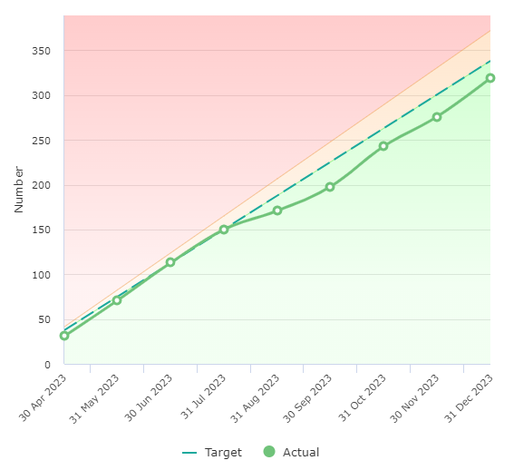
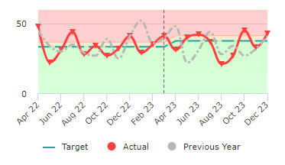
Priority 1 – Number of accidental dwelling fires
317 at end of Q3
RAG Status – Green
The number of fires in dwellings where the cause of fire was accidental or not known
Reduction Target:
Green < 451
Amber 451- 496
Red > 496
Service Owner
Matt Lloyd
Area – Prevention and Protection (Community Safety)
Commentary and actions (Treat or Tolerate): Current Annual Projection – 422
Performance is as expected and on track

Slide 10
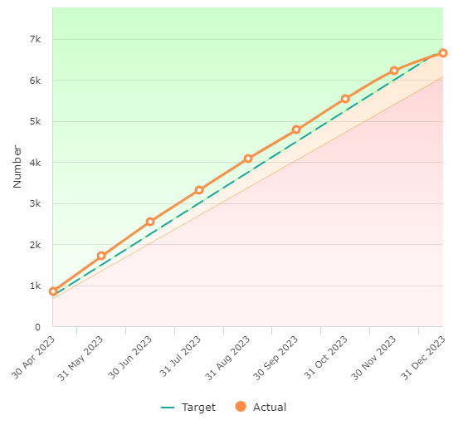
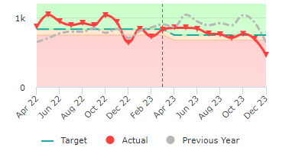
Priority 2a – Undertake 9,000 home safety visits
6,710 at end of Q3
RAG Status – Amber
The number of home fire safety visits where the householder was given fire safety advice and or had a fire alarm installed.
Improvement Target:
Green > 9,000
Amber 8,100 - 9,000
Red < 8100
Service Owner
Matt Lloyd
Area – Prevention and Protection (Community Safety)
Commentary and actions (Treat or Tolerate): Current Annual Projection – 8,930
Projected year end result is within 10% of the target

Slide 11
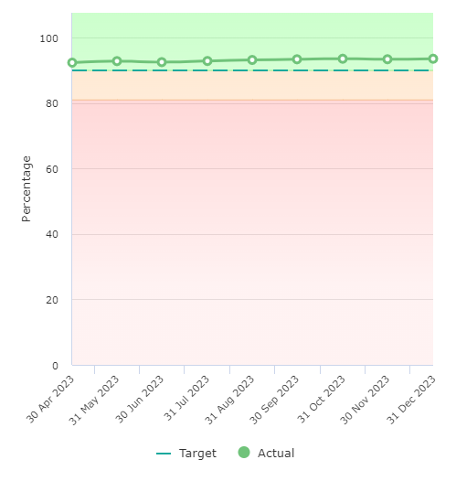
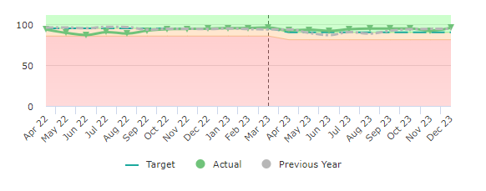
Priority 2b – Deliver 90% of all home safety visits to vulnerable members of our community.
93.6% at end of Q3
RAG Status – Green
Vulnerability is defined as lone pensioners, people over 65, people in rented accommodation, single parent families, hearing /sight impaired and those with a limiting long elderly.
Improvement Target:
Green > 90%
Amber 81% - 90%
Red < 81%
Service Owner
Matt Lloyd
Area – Prevention and Protection (Community Safety)
Commentary and actions (Treat or Tolerate): Current Annual Projection – 93.6%
Performance is as expected and on track

Slide 12
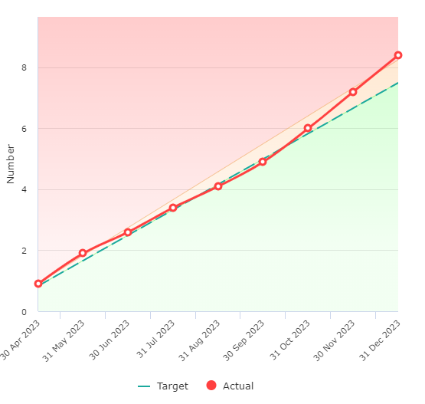
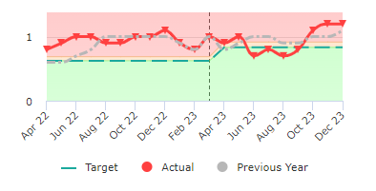
Priority 3 – Reducing the number of absences of our employees due to sickness
8.4 at end of Q3
RAG Status – Red
The number of days/ shifts lost to sickness divided by the number of staff in post
Reduction Target:
Green < 10
Amber 10 -11
Red > 11
Service Owner
Jules King
Area – People Strategy
Commentary and actions (Treat or Tolerate): Current Annual Projection – 11.2
There has been an increase in short term absence in Q3 as has been the case in previous years and can be mainly attributed to colds, sore throat and other seasonal absences. There are still a number of long-term sickness cases within the service and these are being managed through appropriate processes with HR, managers and Occupational Health.

Slide 13
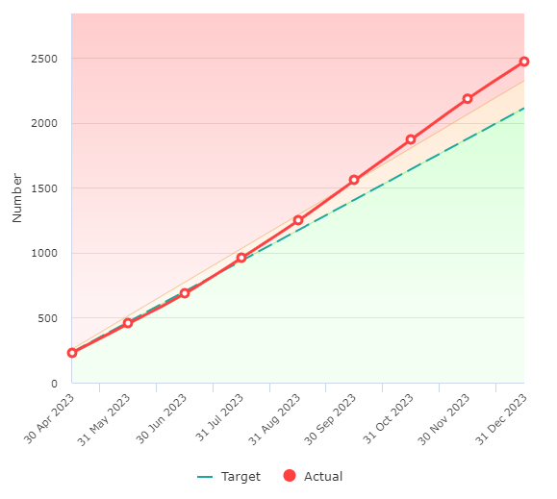
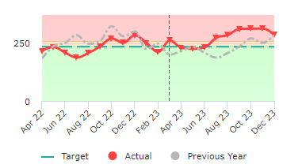
Priority 4 – Reducing attendance at automatic false alarms
2,464 at end of Q3
RAG Status – Red
Number of automatic fire alarms incidents attended to properties covered by the Fire Safety Order
Reduction Target:
Green < 2,820
Amber 2,820 - 3,102
Red > 3,102
Service Owner
Matt Lloyd
Area – Service Delivery (Business Safety)
Commentary and actions (Treat or Tolerate): Current Annual Projection – 3,279
Overall, the stats are similar between Q2 and Q3. The increase was from Q1, when we had around 100 extra sleeping UwFSs and around 80 more non sleeping UwFS.
There is no specific trend or cause, this is as a result of more calls and supports the reason why we are changing policy on 1 April 2024. This will assist and pave the way to look at Carelink / Careline premises.

Slide 14
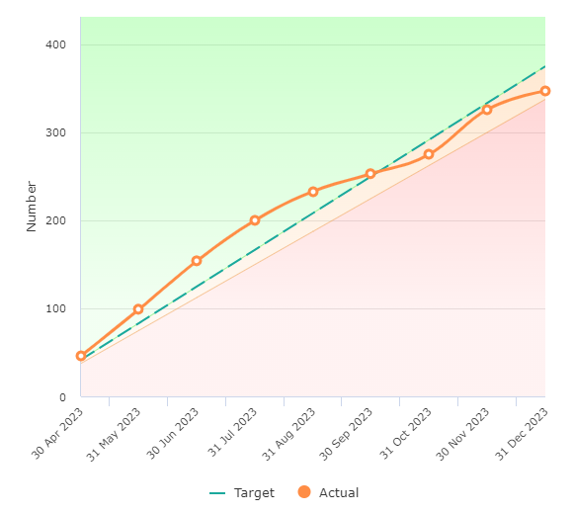
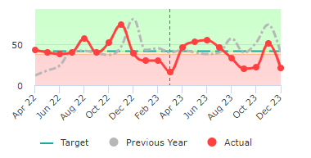
Priority 5 – Inspections of high-risk premises completed
347 at end of Q3
RAG Status – Amber
The number of audits / inspections completed within East Sussex as provided from the reinspection list
Improvement Target:
Green > 500
Amber 450 - 500
Red < 450
Service Owner
Matt Lloyd
Area – Service Delivery (Business Safety)
Commentary and actions (Treat or Tolerate): Current Annual Projection – 462
Projected year end result is within 10% of the target

Slide 15
Performance measures needing improvement

Slide 16
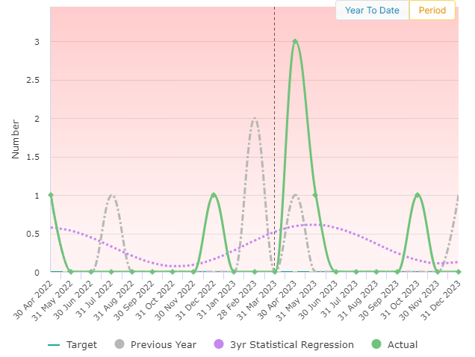
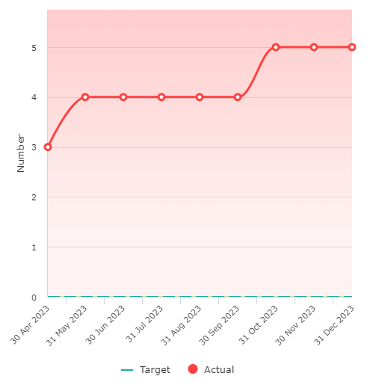
PI 09 – Number of primary fire deaths
5 at end of Q3
RAG Status – Red
The number of people whose death was caused by fire in a major fire which involves property, casualties or 5 or more appliances the death may occur weeks or months later.
Reduction Target:
Green = 0
Amber > 0-3
Red > 3
Service Owner
Matt Lloyd
Area – Prevention & Protection (Community Safety)
Commentary and actions (Treat or Tolerate): Current Annual Projection – 6
This KPI has recently been reviewed and agreed that we strive to have no fire deaths within a year, therefore, any deaths will result in this KPI being red. The service undertakes fatal fire reviews after every fatal fire to determine any outcomes in respect of prevention activities.
There were no fatalities in Quarter 2.

Slide 17
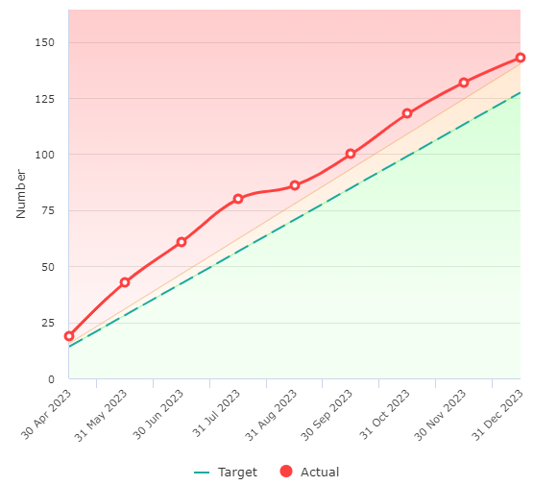
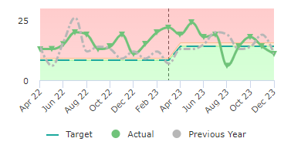
PI 21 – Number of workplaces reported accidents / injuries
143 at end of Q3
RAG Status – Red
The number of safety events received
Reduction Target:
Green < 170
Amber 170 – 187
Red > 187
Service Owner
Julie King
Area: Health, Safety and Wellbeing
Commentary and actions (Treat or Tolerate): Current Annual Projection – 190
Q2 There is a decrease in reported incidents in the second quarter of 2023/24, but still off target for the annual KPI of <170. Note PI21 includes injuries, near hits, vehicle/equipment damage and ill health. ESFRS has a proactive reporting culture, which supports trend analysis and development of targeted campaigns, communications and training. One trend identified was increased manual handling injuries, due to higher attendance at SECAmb incidents, handling casualties in restricted environments e.g. staircases and the age profile of the operational workforce. Enhanced manual handling training has been developed with targeted information on equipment that can be used for casualty extraction in restricted spaces.

Slide 18
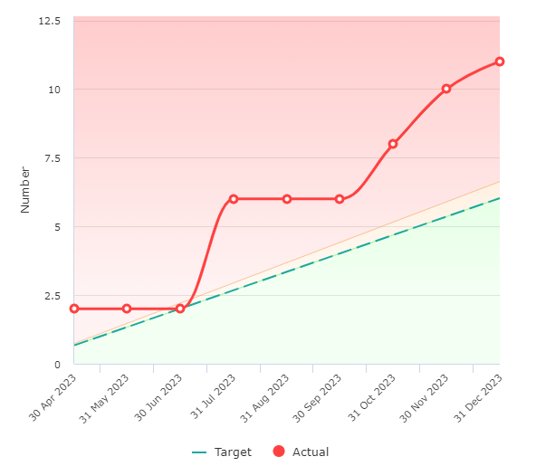
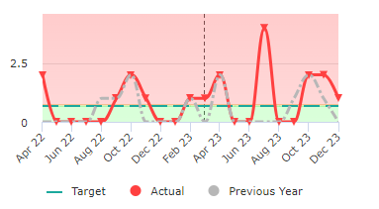
PI 20 – Number of RIDDOR incidents
11 at end of Q3
RAG Status – Red
The number of incidents required to be reported under the Reporting of Injuries, Diseases and Dangerous Occurrences Regulations 1995 that were reported to the Health & Safety section through the Service’s accident reporting procedure.
Reduction Target:
Green < 5
Amber 6
Red > 6
Service Owner
Julie King
Area: Health, Safety and Wellbeing
Commentary and actions (Treat or Tolerate): Current Annual Projection – 15
Q3 There is an increase in RIDDORs in the third quarter of 2023/24 and still off target for the annual KPI of <8. The 5 RIDDOR reports made to the HSE in Q2 2023/24 were:
1 x Dangerous Occurrence: Firefighter exposed to hazardous substance: Exposure to blood from casualty who is HIV positive; and
4 x > 7 day absence: Slip, trip, fall, causing shoulder dislocation. Tripped over coupling while walking backwards at operational incident;
Slip, trip, fall, causing sprained shoulder. Firefighter fell over backwards and hit wall, when removing fire kit.
Member of support staff struck head against a wall mounted cupboard with the door left open. Concussion sustained.
Firefighter twisted knee when dismounting appliance onto an uneven surface.

Slide 19
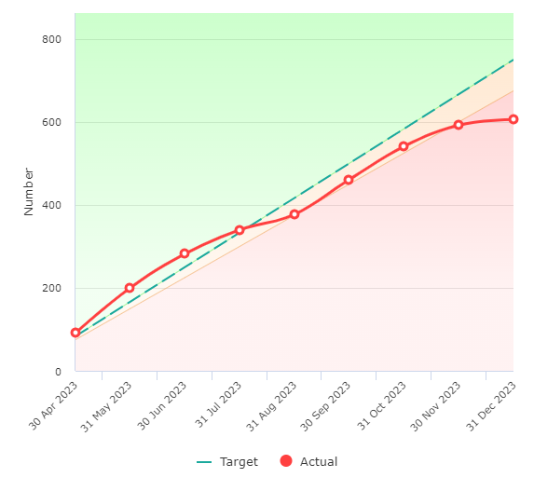
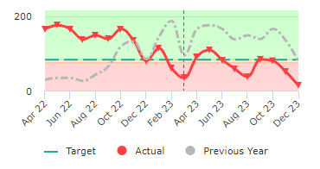
PI 16 – Number of Operational Business Safety Visits completed
606 at end of Q3
RAG Status – Red
Total number of Fire safety checks undertaken and completed by operational crew members and officers.
Improvement Target:
Green > 1,000
Amber 900 – 1,000
Red < 900
Service Owner
Matt Lloyd
Area: Prevention and Protection (Protection)
Commentary and actions (Treat or Tolerate): Current Annual Projection – 806
Fire Safety Checks are showing as 606 completed, meaning that we are 394 short of target. In relation to audits, we are currently at 366, meaning that we are 144 short of target. We forecast a shortfall of approximately 100 visits at the end of Q4. To mitigate this, teams will revert to 4 per watch per month target. In terms of explanation, the focus of Protection Trainees and New Starters this year has been prioritised on legal works. Protection staff have been able to deliver legal cases, with 22 summons in court (as of 25th January), with a further 3 cases being issued summons imminently. We have also prioritised the delivery of training to crews on the CRM Fire Safety Module which has impacted Protection Staff as the trainers and Operational Crews receiving the training. We have also been using protection staff to help ‘user acceptance test’ and plan our upgraded CRM database. Further works around reducing Standby's which take our wholetime stations away from their working areas has commenced. We also plan to enable our staff to access and complete work allocated to other work groups. Doing this will enable crews to carry out effective work, even when on standby duties. Therefore, this priority work will considerably assist with risk reduction, which was the strategic aim.

Slide 20
Annual Performance Measures and new performance measures

